Slide 1

Online Delivery Management System
Prabah

Slide 2
System Analysis and Design Capston Project Course Code: SE231
Submitted By Name: Erin Jahan Eshita ID: 0242310005341074
Name :Abidur Rahman Jisan
ID: 0242310005341333
Name: Ashik Ahmed
ID: 0242310005341334 Section: 40 (H)
Submitted To Arpita paul Lacturer Department of Software Engineering, FSIT Daffodil International University

Slide 3
Table of contents
Introduction
Background
Objectives
Methodology
Purpose and Scope
Terget User
Key Features
System Design(Diagram)
Technical Requirements
Development Cost
Benefits of ODMS
Challenges & Risks
Future Enhancements
Conclusion

Slide 4
Introduction
The Online Delivery Management System is a software application developed to automate and manage various delivery operations, such as order processing, real-time tracking, inventory control, and delivery scheduling. The system aims to enhance the efficiency and reliability of the delivery process, ensuring timely and accurate deliveries. It is designed to streamline operations for both businesses and customers, while maintaining data integrity, security, and user satisfaction.

Slide 5
Background
Problem Statement:
Manual order processing leads to delays and errors.
Lack of real-time tracking frustrates customers.
Poor communication between businesses, delivery personnel, and customers
Solution:
ODMS automates delivery management with real-time tracking, seamless communication, and analytics.

Slide 6
Objectives
Automation
Automate order placement and tracking
Optimization
Optimize delivery scheduling and routing
Communication
Enhance communication between stakeholders
Payment
Provide secure payment integration

Slide 7
Methodology
Development Phases:
Requirement Analysis (SRS Documentation).
Design (System architecture, UI/UX).
Coding (Web platform development).
Testing (Functionality, security, usability).
Deployment & Finalization (User manuals, tutorials).

Slide 8
Purpose and Scope
Purpose:
Replace manual processes with automation.
Enhance customer satisfaction and business efficiency.
Scope:
Features: Order management, tracking, inventory, analytics.
Users: Businesses, customers, delivery personnel.
Constraints: English-only, no guest access, dependency on APIs.

Slide 9
Terget User
Customers
Business Owners
Delivery Personnel
System Administrators

Slide 10
Key Features
Order Placement – Browse products, place orders, set preferences.
Real-Time Tracking – Live GPS updates for deliveries.
Delivery Scheduling – AI-based route optimization.
Payment Integration – Credit/debit cards, digital wallets, COD.
Communication System – In-app chat between customers & delivery agents.
Business Analytics – Sales, delivery performance, customer insights.

Slide 11
System Design / Architecture
Diagram Type to Design:
Use case diagram
Class Diagram
Entity-Relationship (ER) Diagram
Block Diagram
Workflow / Process:
Activity Diagram
State Diagram
Sequence Diagram

Slide 12
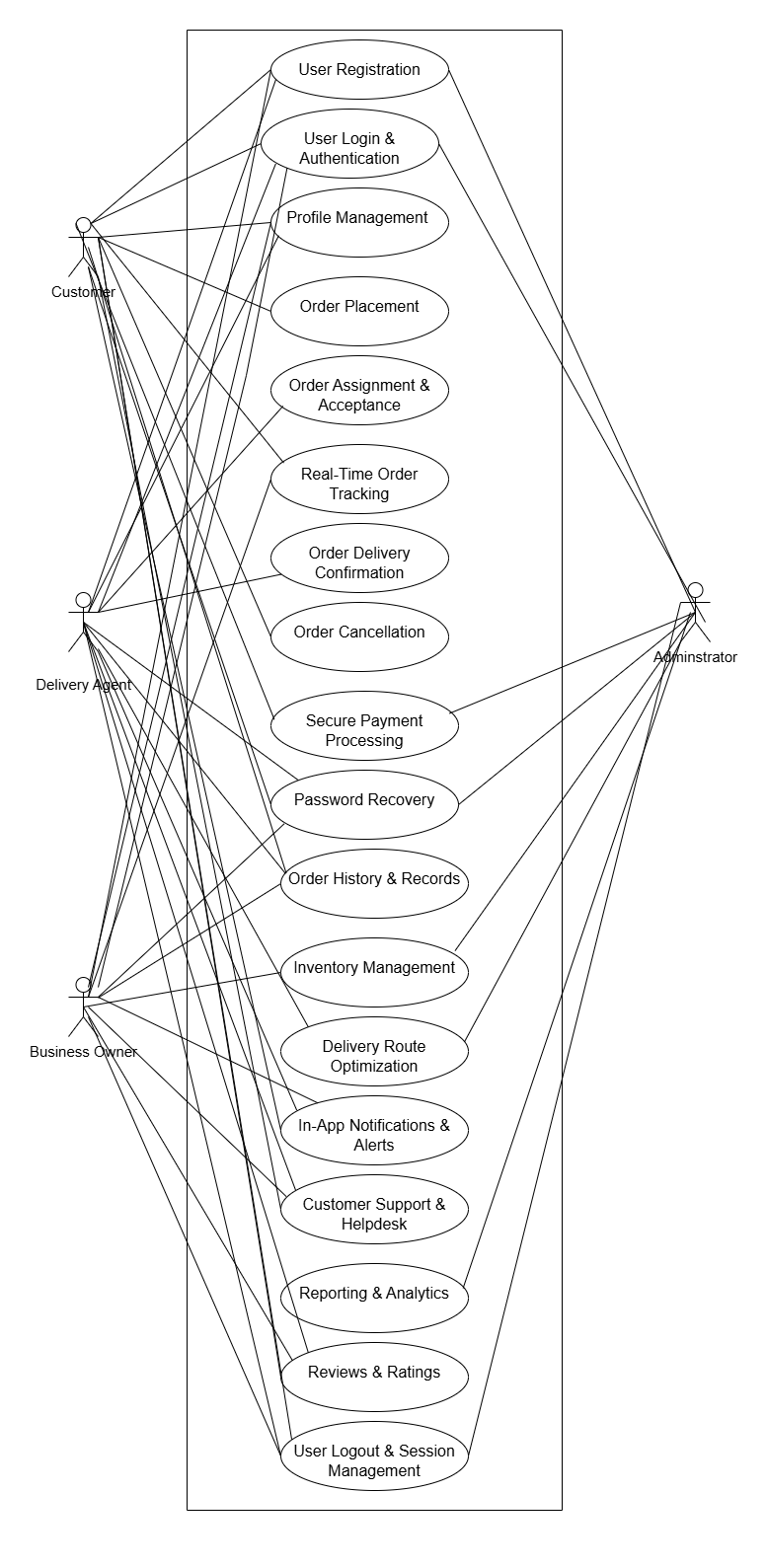
Use Case

Slide 13
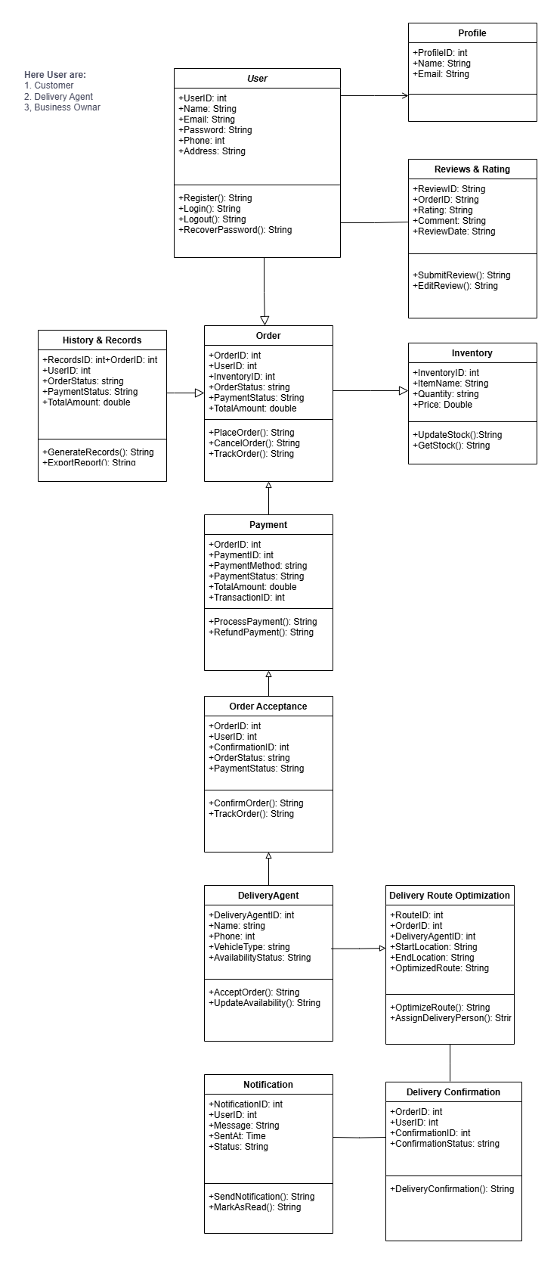
Class Diagram

Slide 14
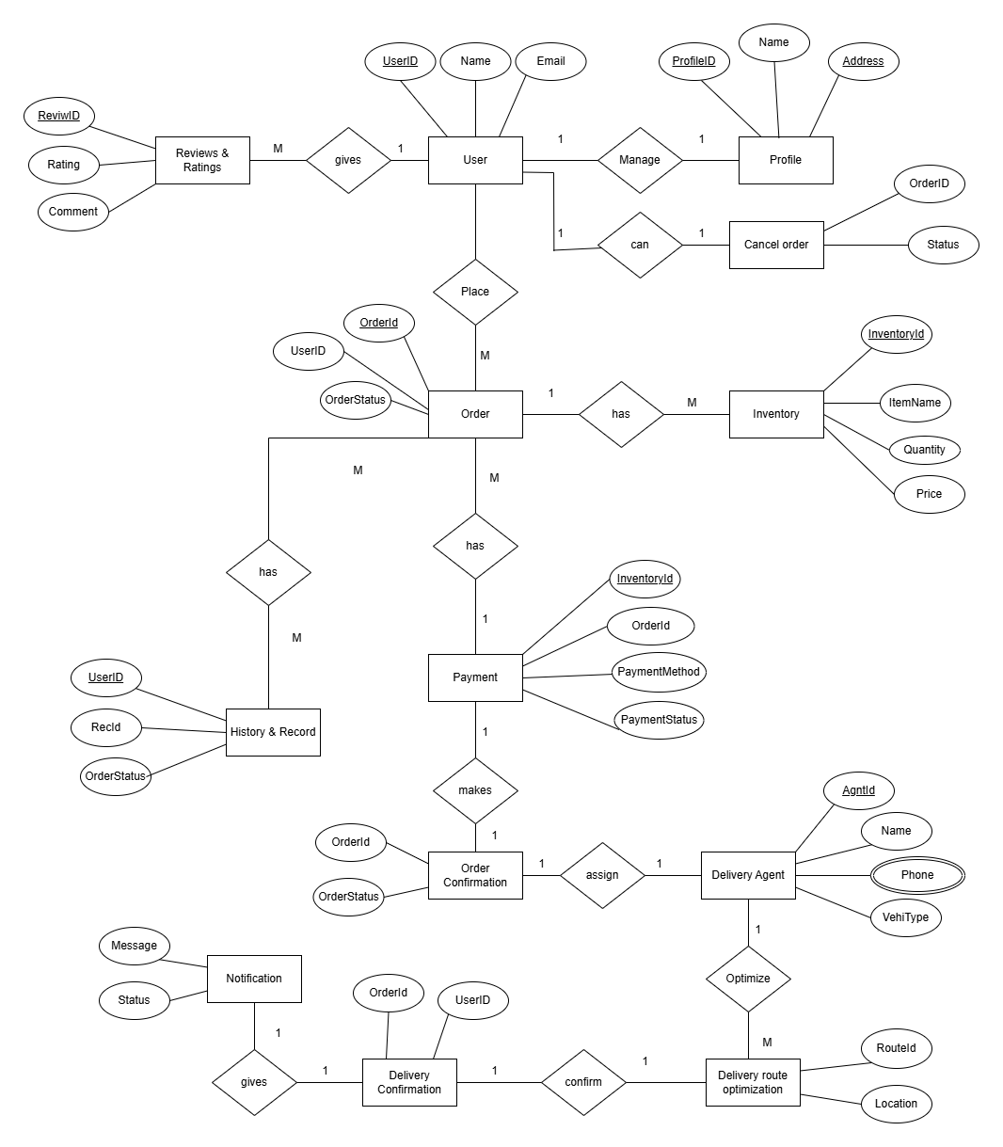
Entity-Relationship (ER) Diagram

Slide 15
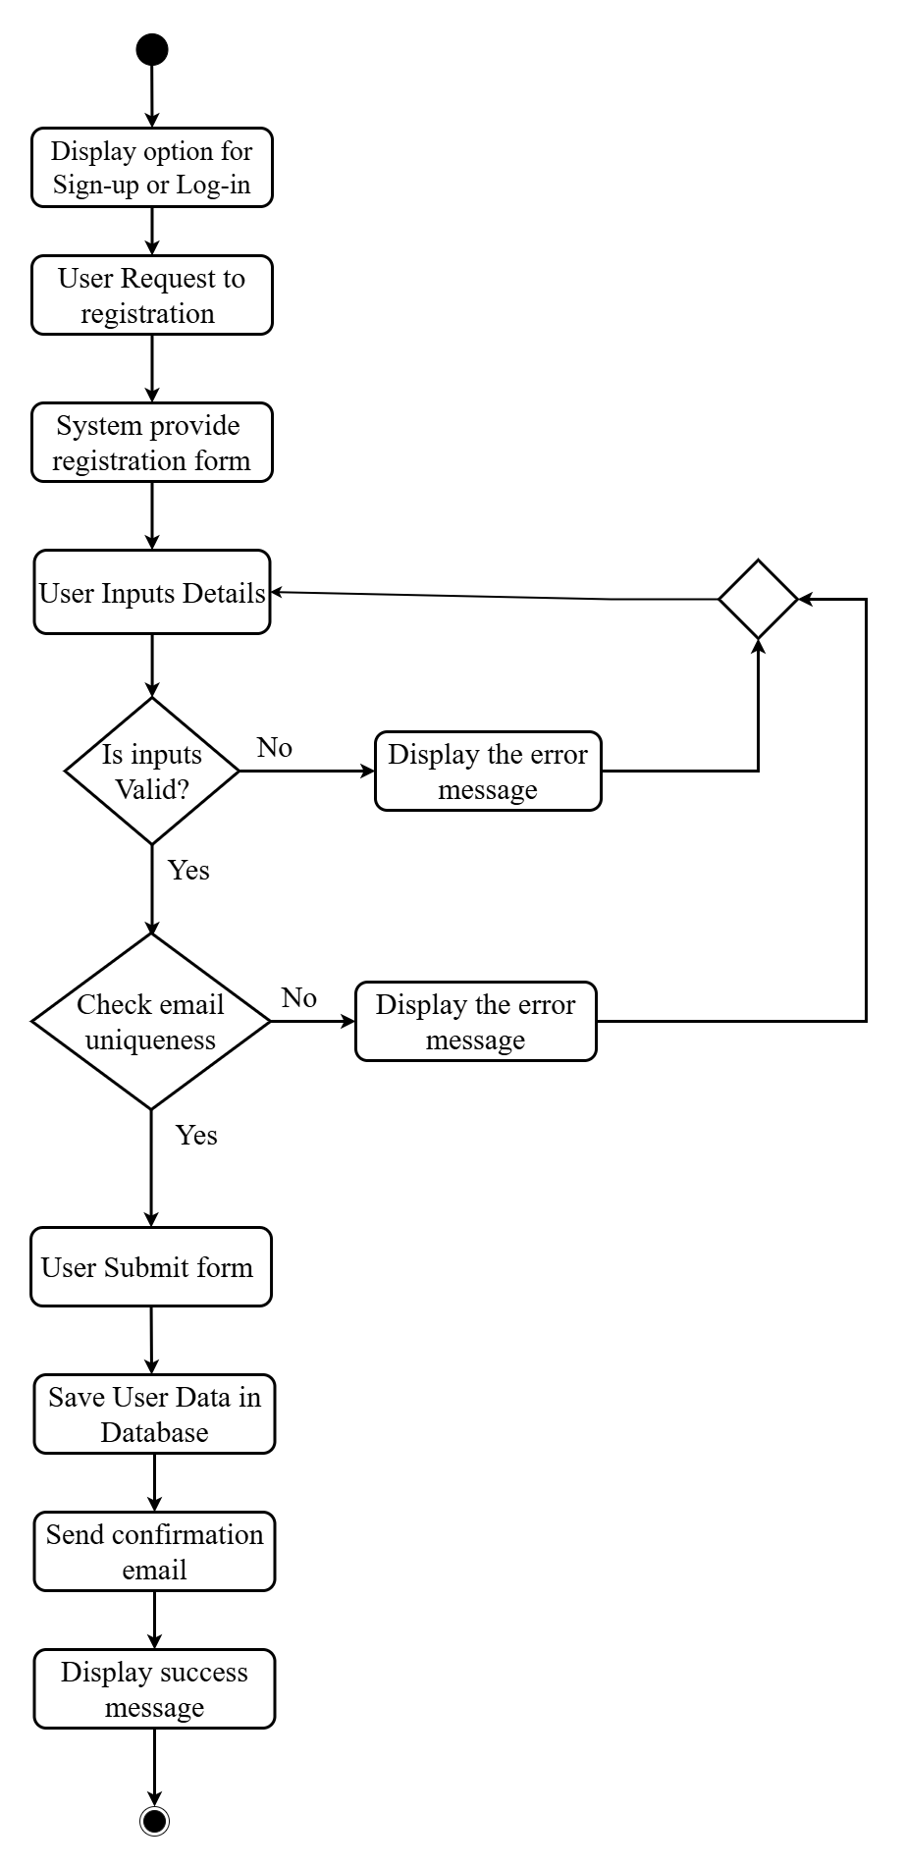
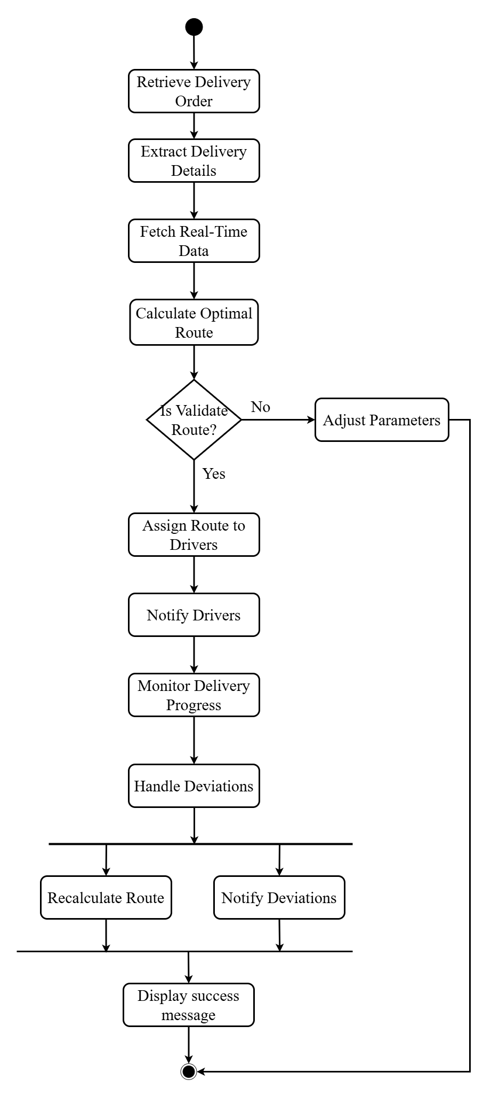
Activity Diagram
Sign up
Login
Delivery Route Optimization

Slide 16
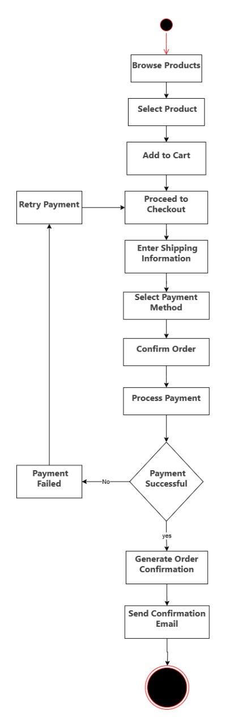
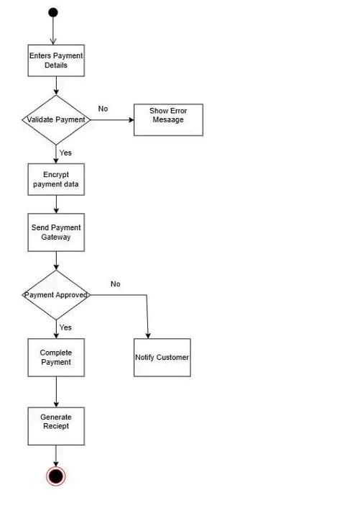
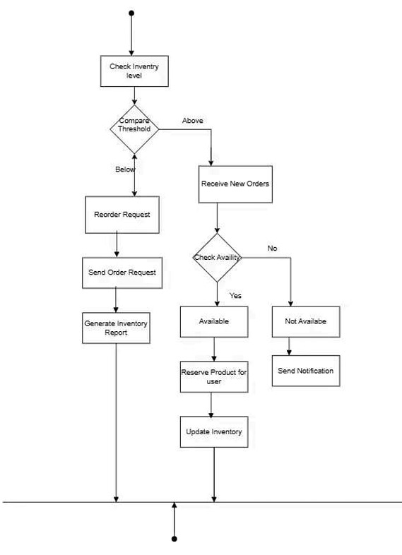
Order Placement
Secure Payment Process
Inventory Management

Slide 17
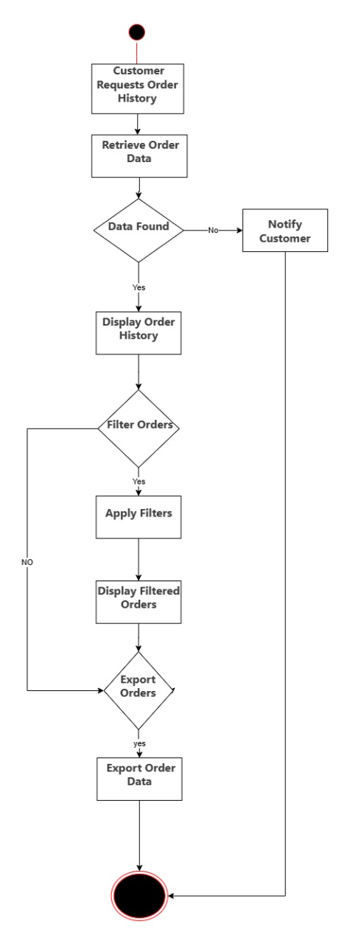
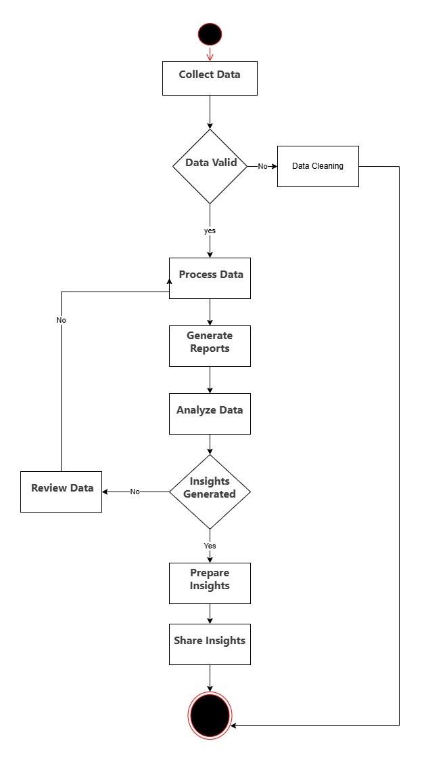
Order History and Record
Reporting & Analytics

Slide 18
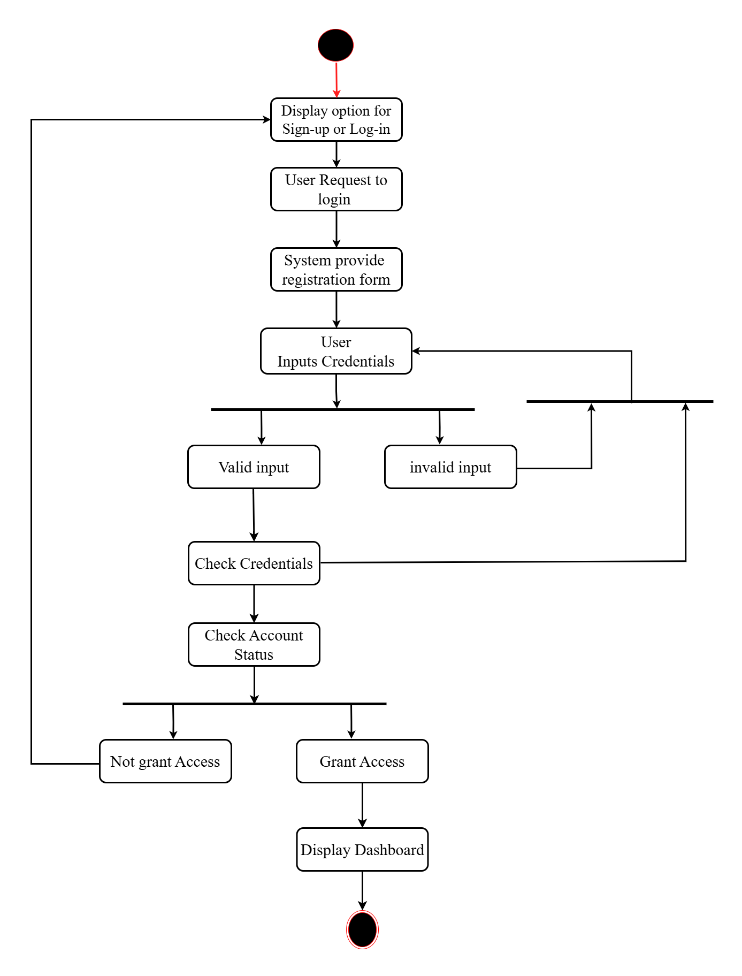
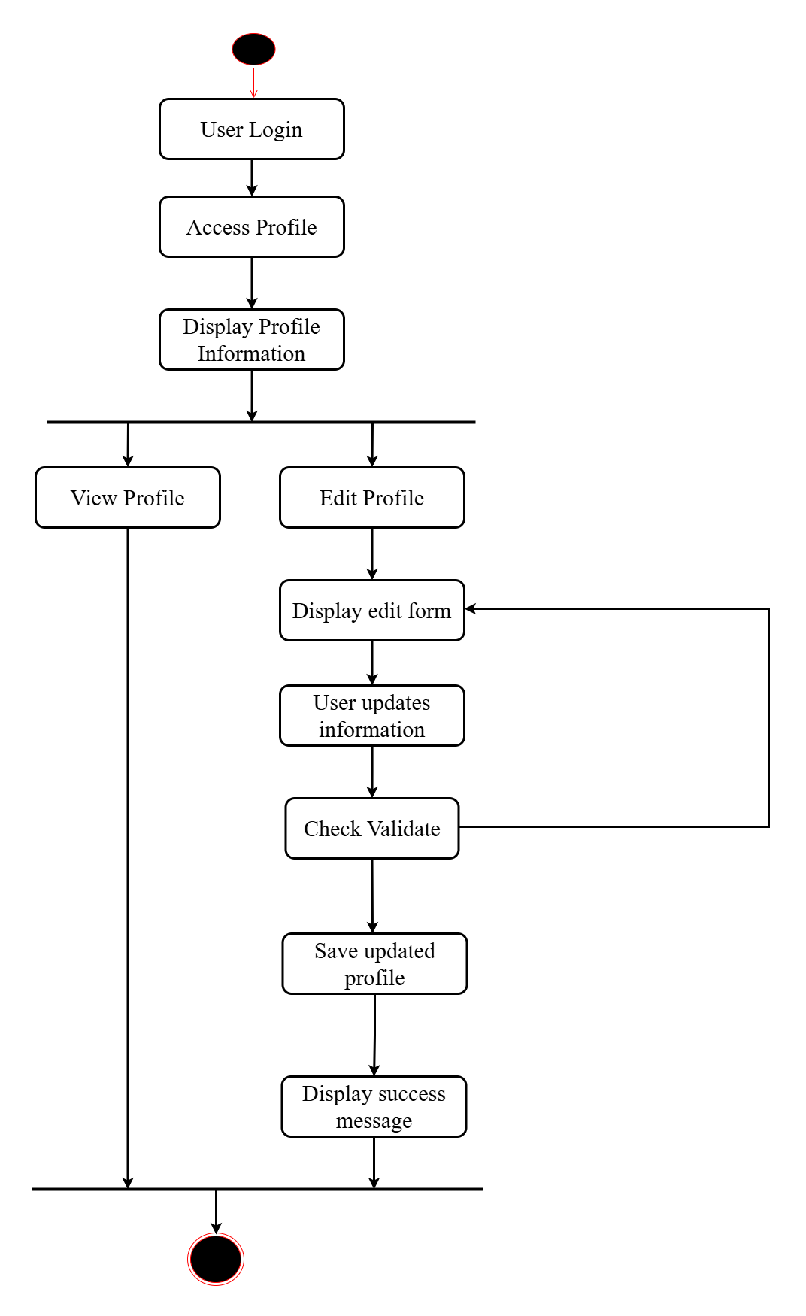
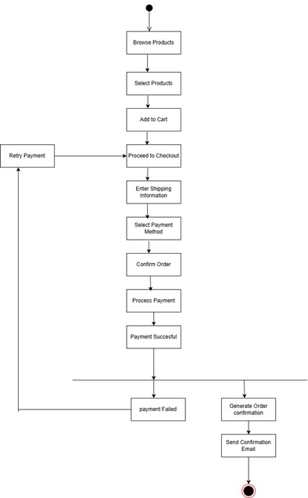
State Diagram
Login
Profile Management
Order Placement

Slide 19
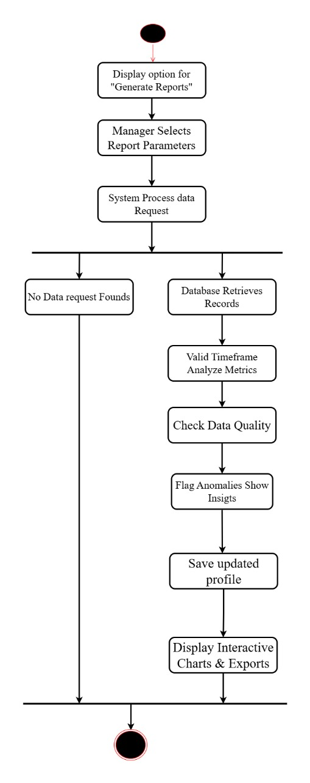
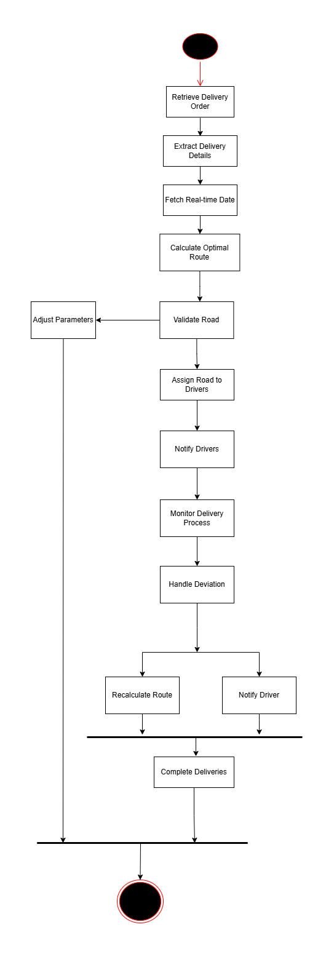
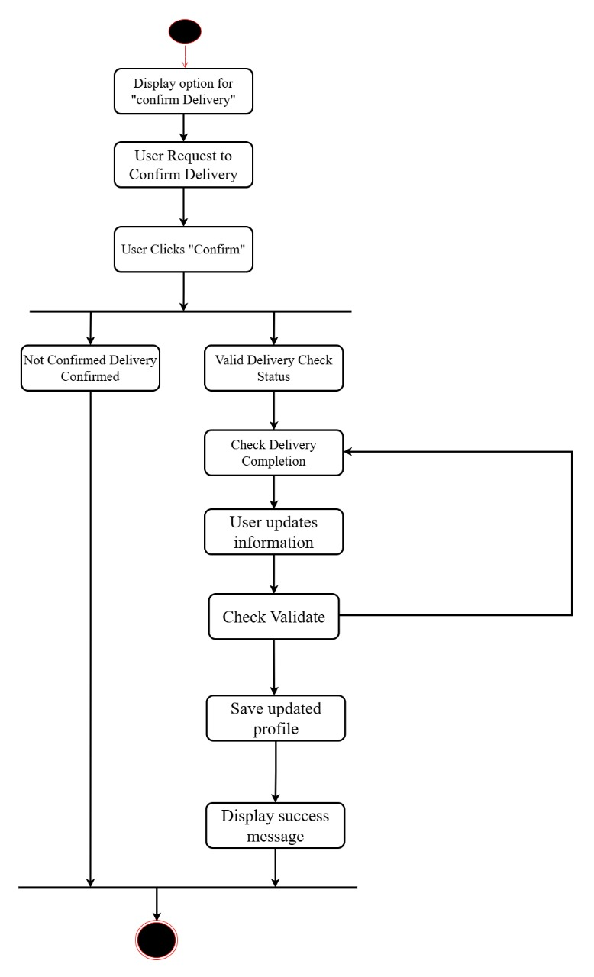
Order Delivery Confirmation
Report Analysis
Delivery Route Opitimization

Slide 20
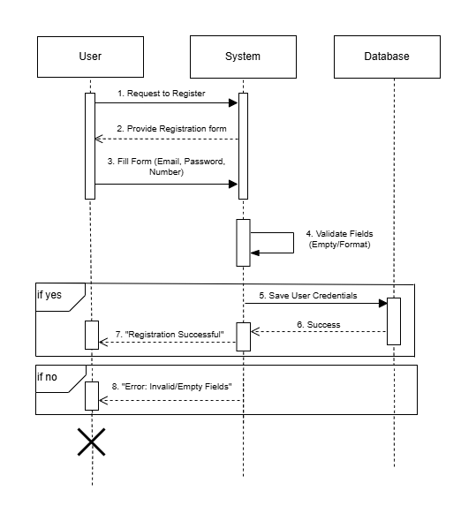
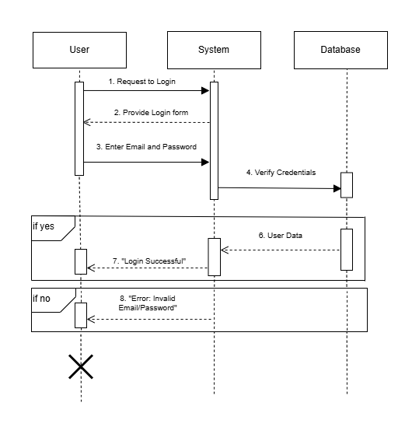
Sequence Diagram
Sign up
Login

Slide 21
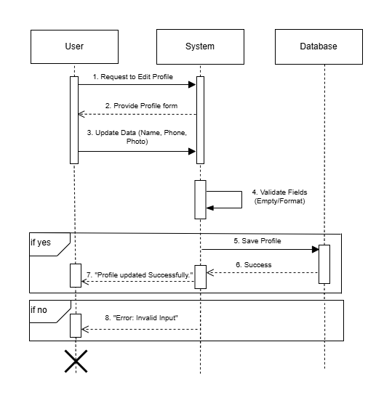
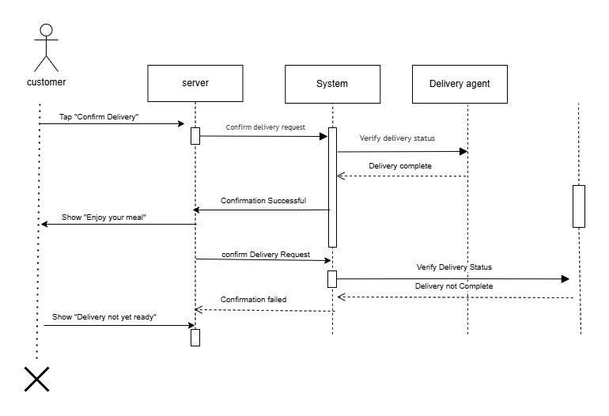
Profile Management
Order Delivery Confirmation

Slide 22
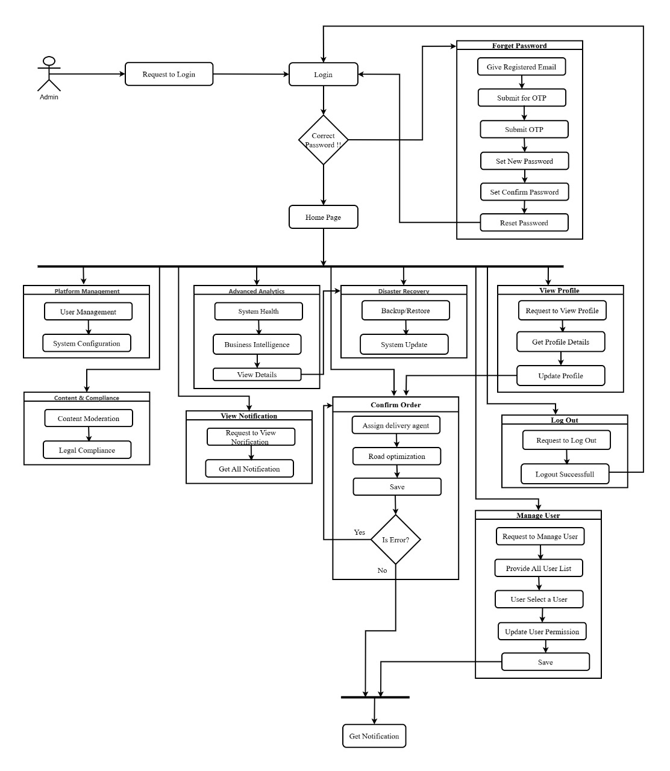
Block Diagram
Block Diagram for Admin

Slide 23
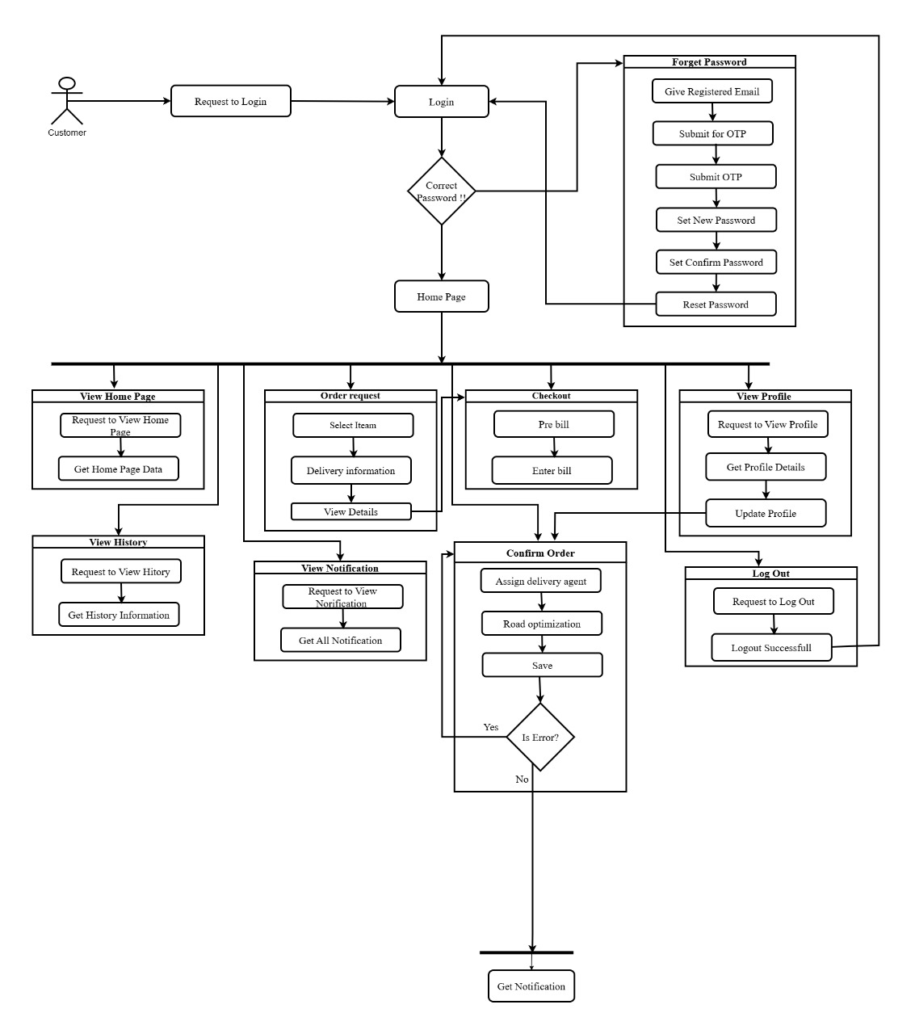
Block Diagram for Customer

Slide 24
Technical Requirements
Hardware
Software
Intel Core i3+
Windows Server
4GB RAM
SQL Server 2008
128GB Storage
NET Framework 4
APIs
Google Maps (GPS Tracking)
Bkash/Nagad (Payments)

Slide 25
Development Cost
Category Estimated Cost (in BDT)
System Analysis & Planning 15,000 – 30,000
UI/UX Design (Web + Mobile) 25,000 – 60,000
Frontend Development (App + Web) 60,000 – 1,00,000
Backend Development (API, DB, Admin Panel) 70,000 – 1,50,000
Mobile App Development (Android, optional iOS) 60,000 – 1,00,000
QA & Testing 15,000 – 30,000
Hosting, Domain, SSL, DB setup 10,000 – 20,000/year
Security Integration (Payment gateway, encryption) 15,000 – 30,000
Maintenance (optional) 5,000 – 15,000/month
Total Estimate: 2,70,000 – 5,35,000+ BDT

Slide 26
Benefits of ODMS
Delivery Efficiency
ODMS enhances delivery efficiency and customer satisfaction. It replaces traditional methods with a smart, scalable system.
Modern Business
ODMS is a strategic tool for modern businesses in the e-commerce era. It optimizes resources and scales with the company.

Slide 27
Challenges & Risks
Dependency on third-party APIs (GPS, Payments).
User adoption (training required for businesses & delivery agents).
Data security risks (encryption & compliance needed).

Slide 28




Future Enhancements
Multi-language support
AI-based demand forecasting
Integration with more e-commerce platforms
Drone delivery compatibility
(long-term vision)

Slide 29
Conclusion
ODMS enhances delivery efficiency and customer satisfaction.
Replaces traditional methods with a smart, scalable system.
A strategic tool for modern businesses in the e-commerce era.

Slide 30
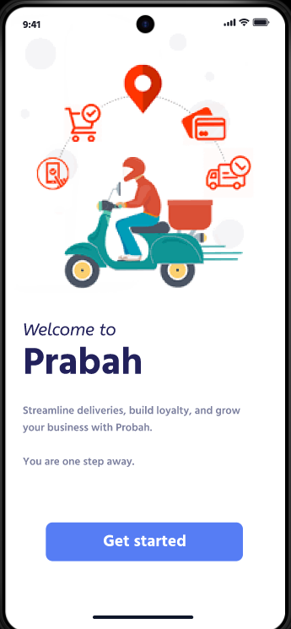
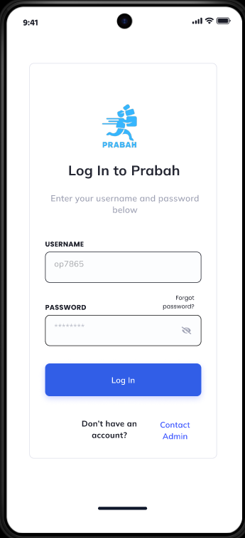
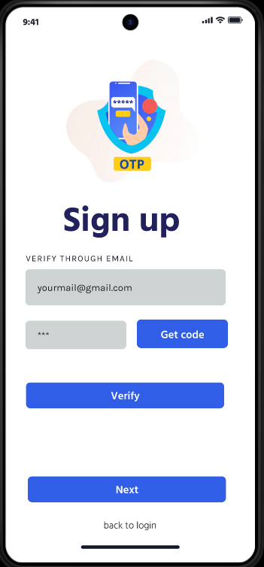
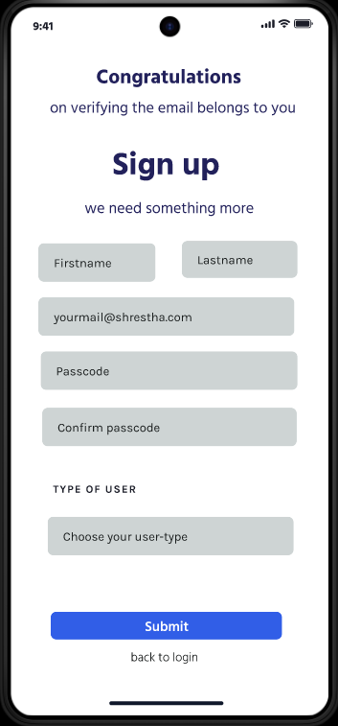
Prototype

Slide 31
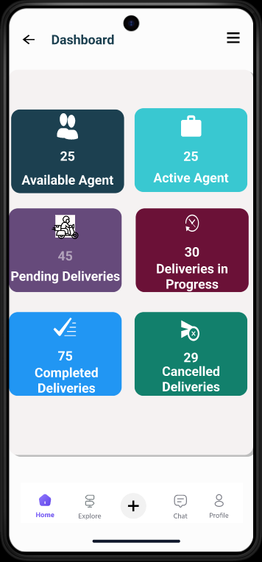
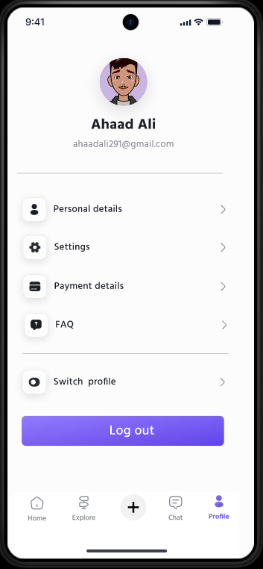
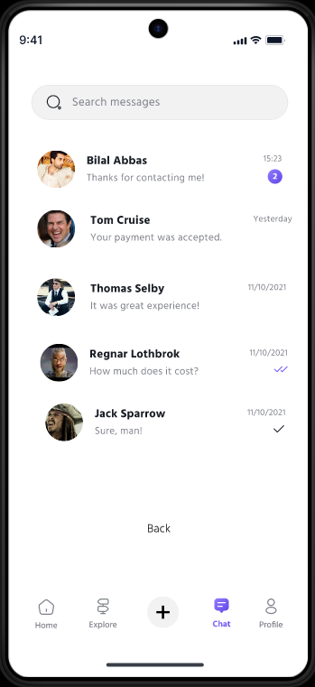
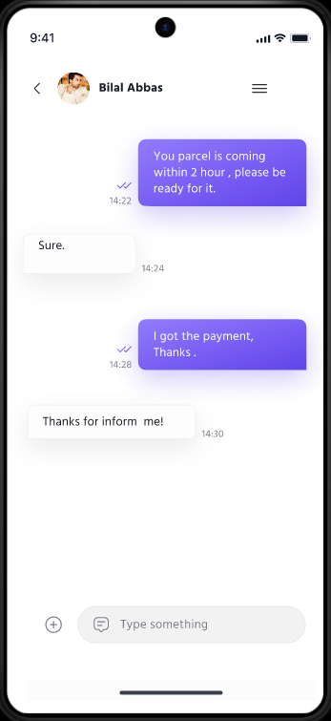
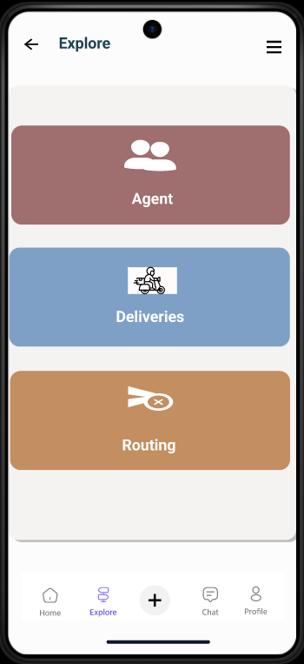

Slide 32
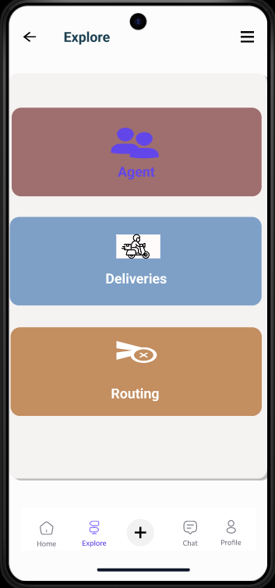
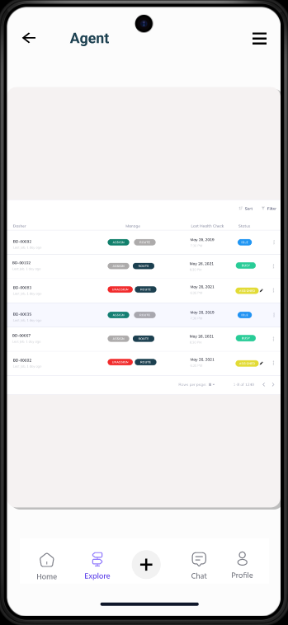
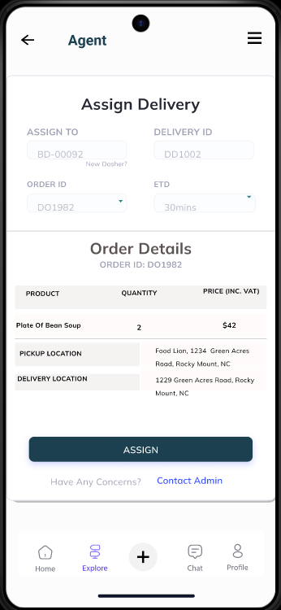
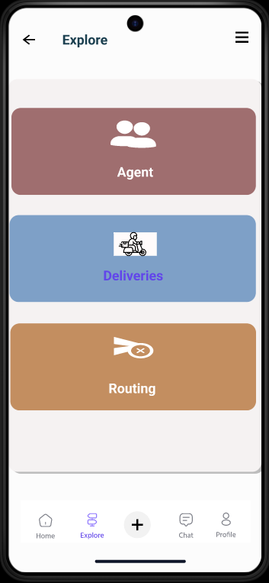
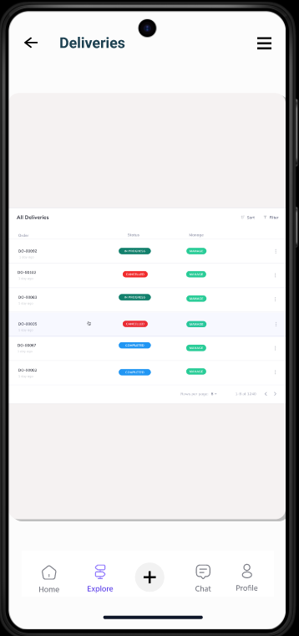

Slide 33
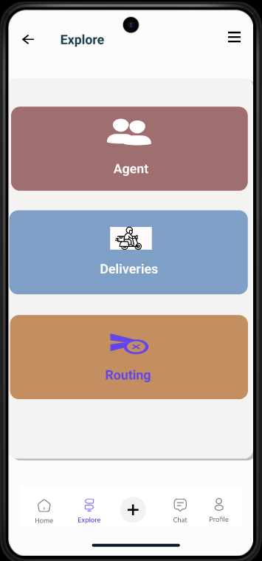
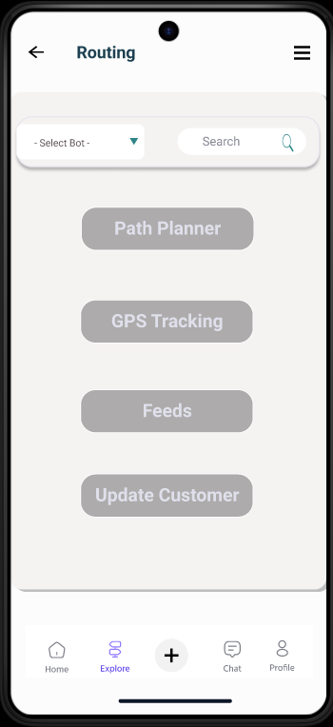
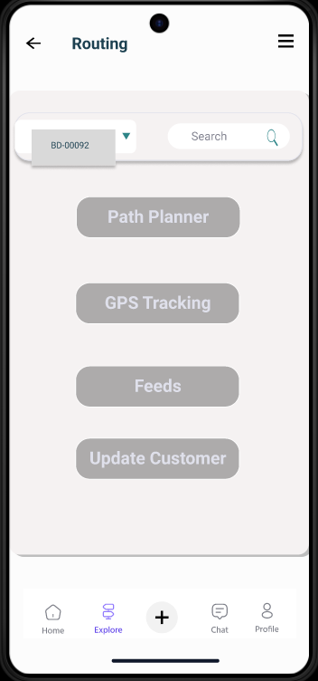
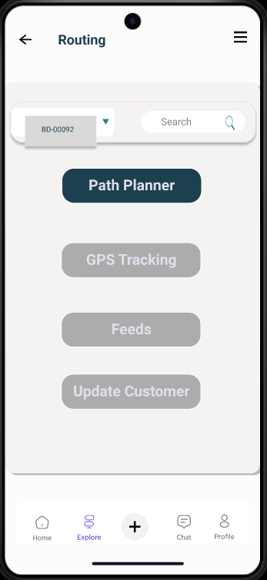
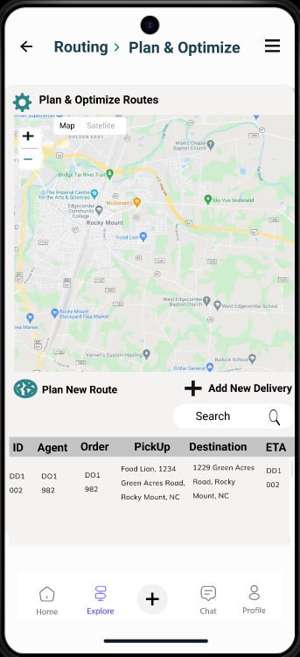

Slide 34
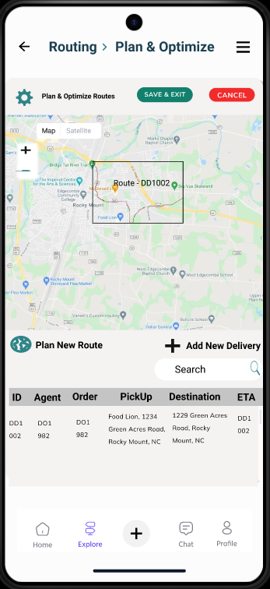
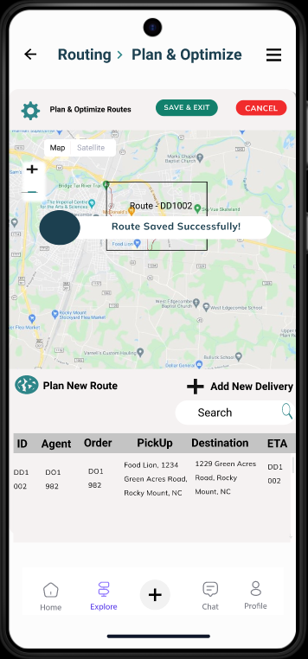
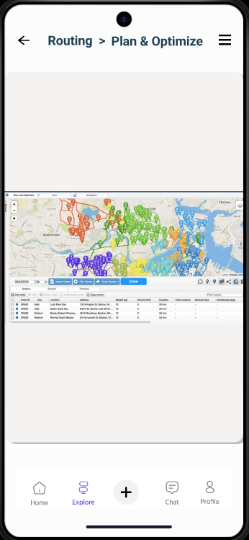
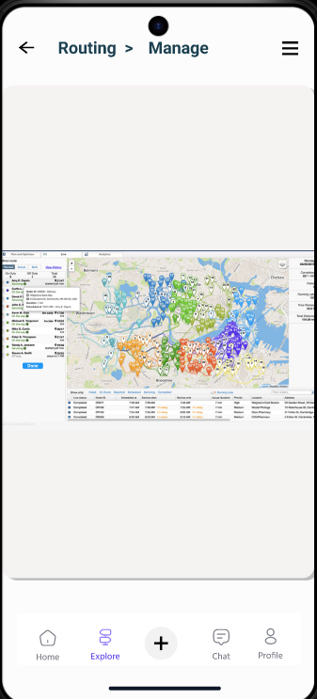

Slide 35
Thank You

